Slide 1
Celebrate Science!
Scientific activities Goshen College students engaged in the past year.

Slide 2
Science Speakers
Jacob Penner, Behavioral and Chemical Ecology of a Sexually Dimorphic Desert Lizard
Joelle Friesen, Investigation into a Putative Fumarate Reductase in Leishmania major
Stuart Kurtz, Pigmentation Genetics of Domestic Pigeons: Pink-eyed Dilution
Jacob Swartley, Domestic Pigeons: The Dilution Series

Slide 3
Conferences
Indiana Academy of Science
  David Jantz, Brenner Burkholder, Nathanael Dick, Tessa Yoder, Aaron Kauffmann & David Slagel, Optical Density Accurately Predicts Dry Mass of Algae Produced in a Buoyant-Lift Photobioreactor
  Aaron Graber, ByeonChan Lim, Hayley Mann, Jacob Roth, Zachary Zimmerman, Caleb Derstine & Deeksha Pagar, Combinatorial Synthesis of Candidate Antibiotics
  Jacob Swartley & Stuart Kurtz, Domestic Pigeons: The Dilution Series
  Stuart Kurtz, Pigmentation Genetics of Domestic Pigeons: Pink-Eyed Dilute
  Jessica Davila, Contractile Measurements from Frog (rana pipiens) Gastrocnemius Muscle Used for the First Time to Study Short-Term Synaptic Plasticity
  Nathan O'Leary, Honey Bee Pheromones: Ethyl Oleate and Alcohol Sensitivity
  Alejandro Genis, Local Drifting Behavior of the Western Honey Bee (Apis mellifera)

Slide 4
Conferences
Butler Conference
  Jessica Davila, Michael Nivens & Amber Mosley, Priming and Memory: The Effects of Body Position, a Type of Body Language Priming, on Memory of Affectively Conotated Words
  Olivia Ginn & Aaron George, Gender Differences in Conformity to Group Behavior
Indiana REU Math Conference and MathFest (Mathematical Association of America)
  Matthew Chen, Nucleolus and Group Monotonicity
  Jon Kaasa, Voting Power in Norway’s Parliament
Mathematical Association of America, Indiana Section:
  Fall: Matt Chen, Crystopher Echavarria, Deeksha Pagar, Sijan Shrestha, Emily Schaeffer
  Spring: Matthew Chen, Abby Flickner, Lucas Harnish, Jon Kaasa, Matthew Pletcher, Peter Schrock, Bryan Yoder

Slide 5
Academic Year Research
Some courses have a research component.
Often there is academic credit available.
Career and graduate study exploration.
Resume builder for job applications & graduate school recommendation letters.

Slide 6
Research Programs
National Science Foundation Research for Undergraduates Programs are offered at a variety of colleges and universities in a variety of research areas.
The Oak Ridge Institute for Science and Education (ORISE) sponsors more than 50 research programs for undergraduate students at national laboratories and other federal research facilities in 24 states and some outside the United States.
David Jantz, Biology Education, University of Georgia
Jacob Penner, Generalist Insect Herbivory and Plant Defense Traits, UC Davis
Peter Wise, Stroud EnviroDIY Mayfly Data Logger and Modbus RS-485 Sensor, Stroud Water Research Center
Vince Kurtz, Learning Robust Failure Recovery for Autonomous Vision Based Flight, Robotics Institute, Carnegie Mellon University

Slide 7
Research Programs
Sophie Sears, Therapeutic effects of natural compounds on cadmium-induced prostate cancer, University of Louisville NCI R25 Cancer Education Program
Kate Crawford, Gastric Cancer Research, IU School of Medicine
Morgan Catron, Algaetown Research, Goshen College
Geoff Miller, Jess Raffel, Ben Wiebe, & Reena Ramo, Ant, Fire, and Elephant Reseach in Kenya
Jacob Roth, Optimizing the Cellular Thermal Shift Assay to Validate Target Engagement in Cancer Drug Development, National Center for Advancing Translational Sciences (NCATS), Summer 2016 Summer Intern Poster Day - Honorable Mention
Morgan Short & Benjamin Wiebe, Sponge, Lobster, and Crab Research in the Florida Keys, Old Dominion University

Slide 8





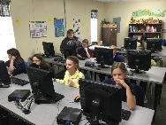
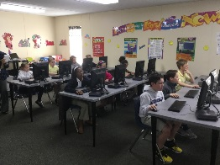
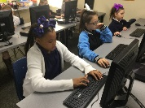

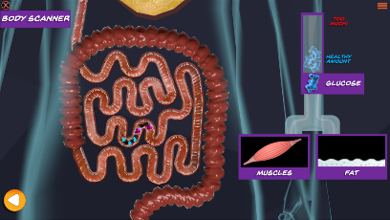
“Sugars are junk foods”: The SYSTEMS Intervention and a Fourth Grader’s Perspective on Human Nutrition
David Jantz¹, Georgia W. Hodges²
¹Goshen College, ²University of Georgia College of Education
Background
Does the game increase understanding of content?
How does connotation of nutritional vocabulary affect nutritional understanding?
Obesity and related health concerns are a huge problem for elementary schoolers in the United States (Ogden et al., 2012). This makes it an age that is critical to target in health education.
Serious educational games have the can help students grasp difficult science concepts (Plass, 2015). SYSTEMS (Stimulating Young Scientists to Engage, Motivate and Synthesize) is a team led by Dr. Georgia Hodges that is building a computer game to teach students about healthy lifestyles, the body systems, and problem solving skills using the claim, evidence, reasoning framework (or CER) (McNeill, 2011).
Completed chapters were pilot tested on a class of forty fourth graders in a local elementary school in February 2016.
Data collected from the students included pre- and post-test data, interview data, and written responses to questions in the game.
We built a scoring rubric based on both the CER framework and core content understanding. We applied the rubrics to score the written response data from the four chapters. We also performed a thematic analysis of open-ended written responses. We presented this data to the team to inform design changes to each of the four chapters.
An overarching goal of the project focuses on helping kids to improve their overall health. This led me to focus on the Human Nutrition chapter in my project. The February research project provided a broad sweep of the students’ knowledge and beliefs. However, it lacks the depth needed to deeply understand the impact of the game on the students’ understanding of what makes a healthy lifestyle. I chose to do an interview to get inside one student’s head to better gauge the impact of the game.
For the case study, Ben (pseudonym) made a good candidate as he scored in the middle/upper part of the class – a good learner that still provided a snapshot of the “typical” fourth grade mind.
I identified important themes from the Human Nutrition chapter and used those to shape my research questions and the questions I asked in the 2-hour interview.
  Energy
  Positively viewed
  Belief: Vegetables have more energy than junk foods.
Can you tell what the foods are based on the picture?
Different from
They're all protein. They're all vegetables and good stuff.
Fuel
Positively viewed
Belief: “The carrots have more fuel than the chips.”
Computer: What are you missing from your meal? You need the _____ because you are missing the _____.
Different from
Pork chop and protein.
So why did you say “pork chop and protein”?
Figure 1: When Ben’s class played the game in February 2016, they showed a 16% improvement on questions about nutrition. Ben showed a 50% improvement.
Calories
Negatively viewed
Belief: “The chips have more calories than the carrots.”
Um, because the meat has protein and he didn't have any protein.
Different from
But what you said earlier was that all of these have protein.
Well, she needed a main meal.
Figure 3: Ben believed that energy, fuel, and calories are different concepts. Class data showed that positive vs. negative-sounding words affected student responses.
Figure 4: Ben had two definitions of protein in his head – one of protein as a generically good word to describe healthy food, and one that actually referred to protein.
How does the game change Ben’s perception of energy flow through the body?
Conclusions
The SYSTEMS game gives students a greater understanding of nutritional concepts: the class showed an average improvement of 16%.
The case study approach allowed for deeper look into one student’s mind. Importantly, all of his changed understandings moved from inaccurate to more accurate, never the other way around.
Ben’s definition of energy grew more nuanced and he gained a greater awareness of the need to balance energy in with energy out.
Ben built a more complex and accurate mental framework in thinking about nutrients: He learned the nutrients foods contain, and their quantities, determine whether they are healthy or not.
Ben and the rest of his class struggled with vocabulary used to discuss concepts. Words were either good or bad in the student’s mind, when in reality nutritional concepts are too complex to be so clear-cut.
Clear definitions of terms are needed to dispel preconceived misconceptions, as in the case of nutrition vocabulary. Clear definitions will also ensure that students learn what food groups are and that sugary and fat-dense foods are not the same.
Ben had limited gains in knowledge after the interview, since he had already played the game before. Future work will be to interview students who have never played it before in order to see the full impact the game has.
Description | Pre-chapter Understanding | Post-chapter understanding
Definition of Energy | Energy is “what you used to move around.” | “Energy is what you get from glucose… you need to use the energy, not just sit around all day.”
Fat stores energy | Does not know what purpose fat serves. | “There’s a little bit of energy in the fat”.
Energy Balance | Calories in and out should balance. | Calories, fuel, and energy in should balance with calories, fuel, and energy out.
Exercise as a Panacea | Overconfident in the power of exercise. All one has to do is “work out a lot, like play outside a ton” and they will be fine, no matter their diet.
Research Questions
How does the Nutrition unit from the SYSTEMS game shape elementary schooler’s understanding of what constitutes a healthy lifestyle?
How does the game change their perception of how energy flows through the body?
How does the game change their perception of what makes a food “healthy”?
How does choice of words with positive vs. negative connotations affect their ability to learn nutritional concepts?
= Changed understanding
= Unchanged understanding
How does the game change Ben’s perception of what makes a food healthy?
Methods
Pre-chapter Interview
Structured format
21 questions long
Addressed themes of energy flow, health of food, and vocabulary
Description | Pre-chapter understanding | Post-chapter understanding
Definition of Junk Food | Defined junk foods by giving examples of different junk foods. | Defined junk foods by what nutrients they contain – “sugar and no protein.”
Sugar and Glucose | Sugar is unhealthy because it “doesn’t have any protein and vitamins or glucose.” | With too much sugar, “you’re going to have too much glucose and it’s going to turn into fat.”
Glucose | “Glucose is good.” | It is possible to have “too much glucose.”
Food Groups | Ben did not learn what food groups are.
Sugar and Fat | “I don’t really think that there is [a difference between sugary and fat-dense foods].”
Group Paraphrased Responses by Code (including class data)
Acknowledgements
In-chapter Interview
Semi-structured format
Ben played the game during questioning
Sought understanding of his thought process
Thematic Analysis
We thank Audrey Hoffman, Gretchen King, Peggy McKay, David Nix, and Alex Turbyfield for their input in our research, as well as the National Science Foundation for their funding of the UBER REU and the UGA Genetics Department for printing this poster.
Open-code and Paraphrase Responses
Post-chapter Interview
Same questions as in Pre chapter interview
Looked for changes in nutritional knowledge
Use Themes to Answer Research Questions
Figure 2: This animation from the game helped students visualize the process of digestion. In this image, a cupcake is shown to deliver too much glucose to the body too fast. The animation led to Ben’s mental connection between sugar and glucose.
References
Transcribe Interview
McNeill, K. L., & Krajcik, J. S. (2011). Supporting Grade 5-8 Students in Constructing Explanations in Science: The Claim, Evidence, and Reasoning Framework for Talk and Writing. Pearson.
Ogden CL, Carroll MD, Kit BK, Flegal KM. Prevalence of obesity and trends in body mass index among US children and adolescents, 1999–2010. JAMA 2012; 307: 483–490.
Plass, J. L., et al. (2015). "Foundations of Game-Based Learning." Educational Psychologist 50(4): 258–283.
Any opinions, findings, and conclusions or recommendations expressed in this material are those of the author(s) and do not necessarily reflect the views of the National Science Foundation.

Slide 9
Internships
David Bontrager, Prairie grazing project and Bird Banding internship at Merry Lea
Molly Zook, Shadowed therapists in a physical therapy center. Was able to have an up-close view of the inner workings in this private clinic and learn much more about the whole field
Grant Flaming, Fish shocking and monitoring stream health in Elkhart and South Bend counties
Micah Weibe-Powell, Altadena Solar in Altadena, California
Brian Sutter, Solution Source
Michelle Espino, Abonmarche

Slide 10
Maple Scholars
Whether it’s exploring the relationship between math and music, testing the stress levels of drunk honeybees, or developing curriculum for a criminal justice course at the county jail, each year Goshen College students spend the summer doing intense study and research during the college’s eight-week Maple Scholars program.
During the program, each scholar is paired with a faculty member who serves as both colleague and supervisor. Creating a community of scholars, the students are all housed together and in the Friday colloquium, scholars take turns presenting the work they are doing and answering questions from other students and faculty. At the end is a celebration day when the results of each project are presented to the public.

Slide 11
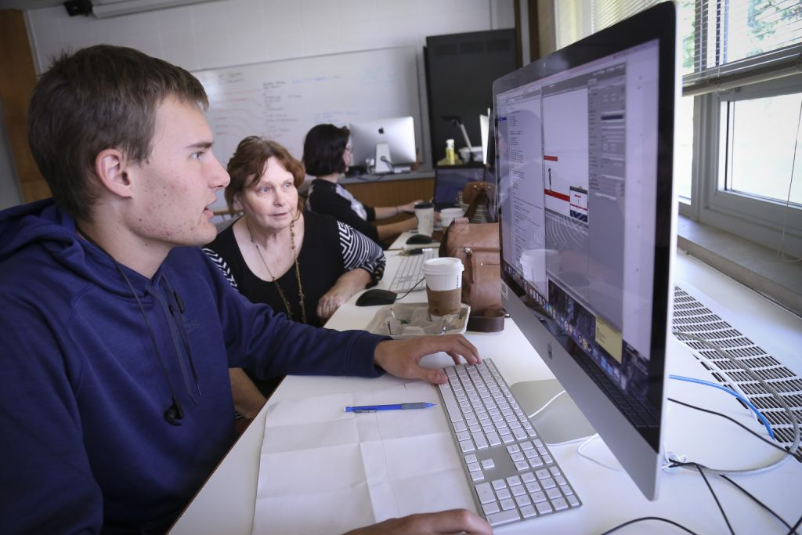
Maple Scholars
Christian Stoltzfus, a sophomore computer science major, and India Potter, a student from Ball State University, worked with Jeanette Shown, associate professor of computer science and information technology, on a project titled “Peace Breaks Out.” They are conceptualized, designed, drew and coded a video game that is entirely nonviolent, with the goal of creating a fully functional game that could be marketed sometime in the future.

Slide 12
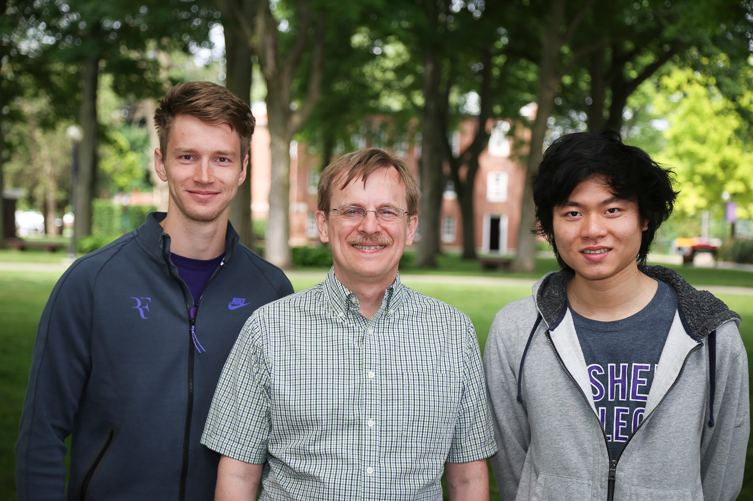
Maple Scholars
Jon Kaasa and Matt Chen, mathematics and physics double majors, worked with David Housman, professor of mathematics, on game theory. Jon explored the fairness of Norway’s system of proportional representation in its legislature. Matt explored when the coalition game nucleolus is group monotone.

Slide 13
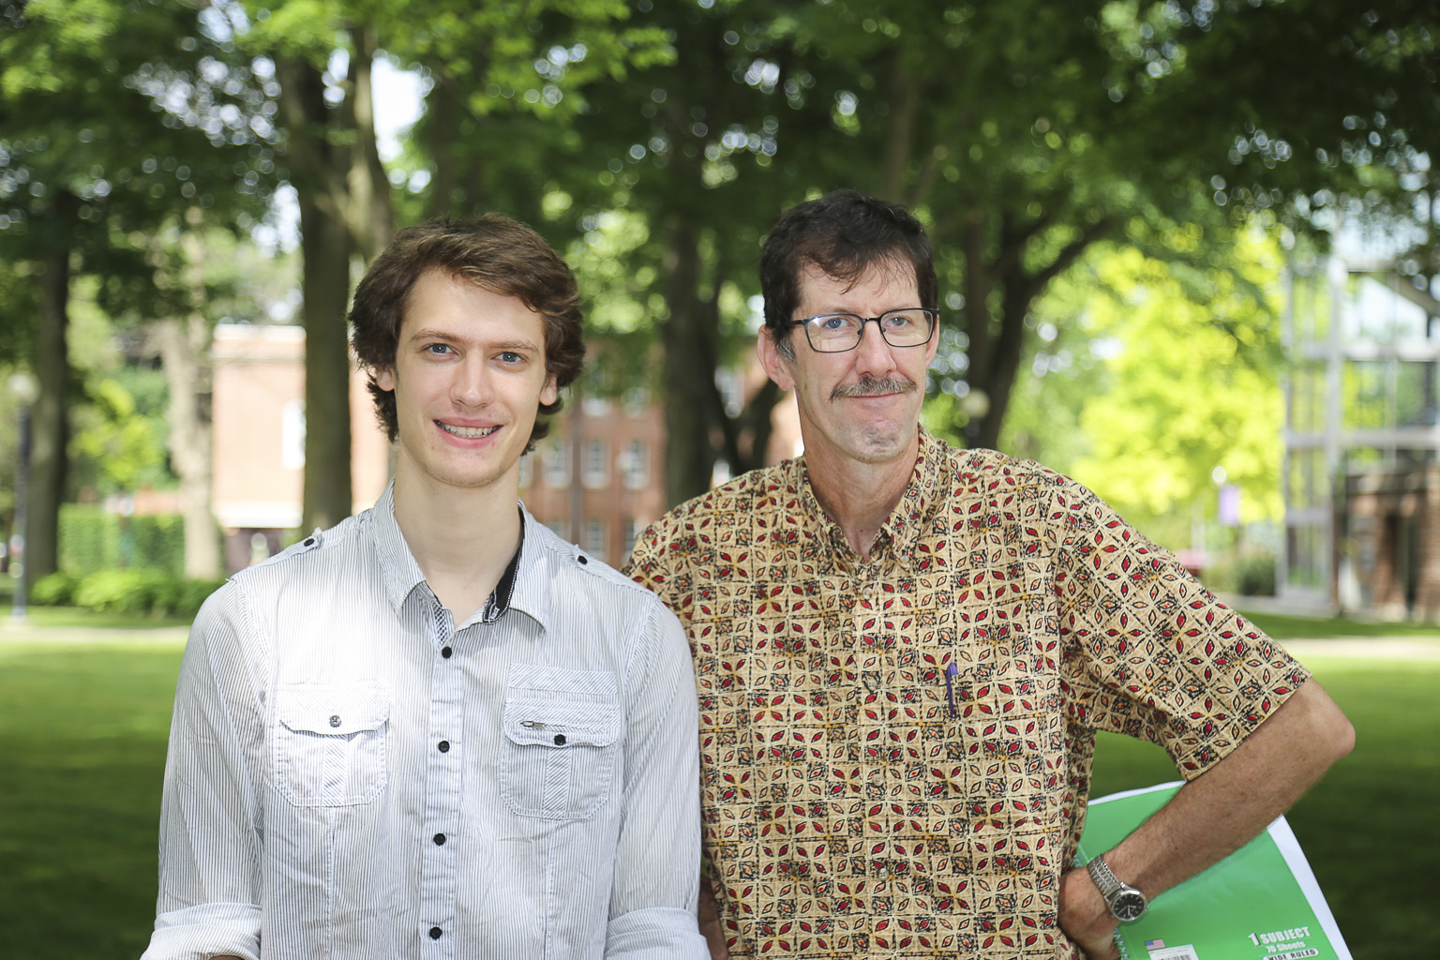
Maple Scholars
Bryan Yoder, a senior physics and mathematics double major from Manheim, Pennsylvania, worked with Paul Meyer Reimer, professor of physics, on a project titled “Gravity & Groundwater.” They examined satellite data that gives the total amount of water stored in every location on earth and compared it with hydrological models, which allowed them to estimate how humans have affected water and groundwater storage across the world.

Slide 14
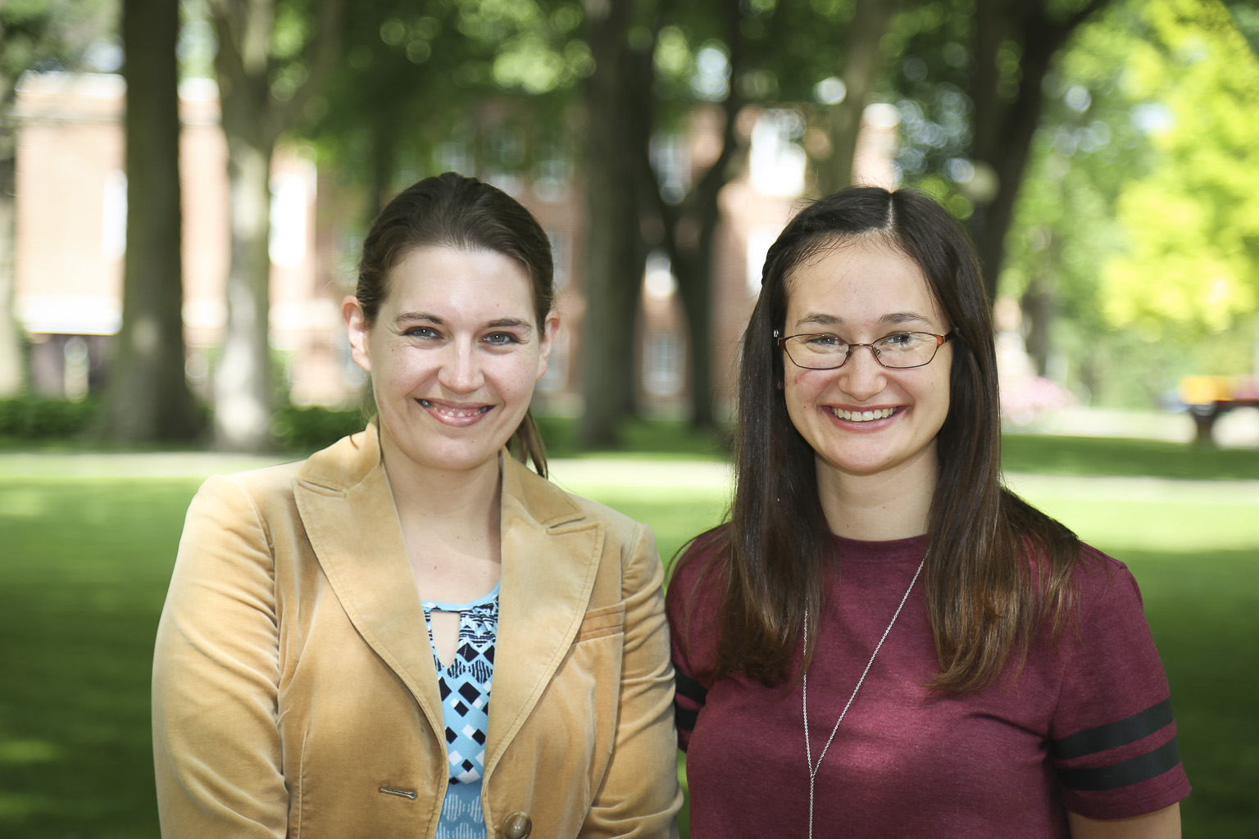
Maple Scholars
Anna Shetler, a junior molecular biology major from Goshen, Indiana, worked with Erin Milanese, head of learning technologies, to compare data from other colleges’ and universities’ iPad programs to Goshen College’s iPad program, in order to determine the future of GC’s use of iPads.

Slide 15

Classroom Technology: Exploring iPad Programs in Higher Education
Anna Shetler
Maple Scholars 2016

Slide 16

Purpose of Project
Help administration determine effectiveness of Goshen’s iPad Program
  Decision in October 2016
Compare Goshen’s program with programs around the world
  What works for other schools?

Slide 17
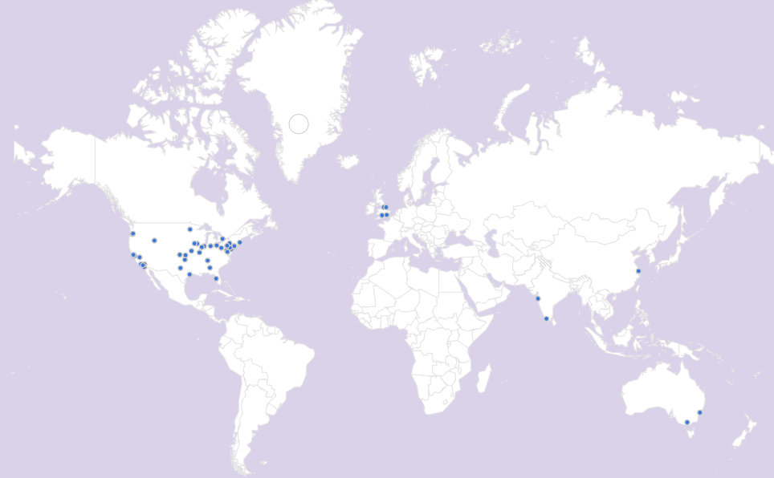
What did I actually do?
Researched schools’ programs online
Created survey
Developed massive spreadsheet
Contacted schools again and again
Good Library
Friday Colloquiums
Group Meals

Slide 18

Pooling the Data
Challenges faced
  Lack of buy-in
  Maneuvering operating system
  Resistance to new technology
  Cost
Advantages seen
  Opportunities for pedagogical development & efficient content creation
  Technology equality
Strategies for overcoming challenges
  Development and training sessions
  iPad-faculty liaison

Slide 19



Continuing the Project
Creation of GC Internal App
Report for Administration
Junior/Senior Research?

Slide 20
Grants
Meghan Gerke and Jeanette Shown, Google IgniteCS, develop and deliver a computer science outreach program in our community

Slide 21
Contests
Association for Computing Machinery Programming Contest: Christian Bechler, Kenan Bitikofer, Matthew Pletcher, Peter Schrock, Christian Stoltzfus & Seth Yoder (one team came in 7th place out of 60 teams in our region)
Putnam Competition: Bryan Yoder (73rd percentile), Peter Schrock & Kenan Bitikofer; GC team ranked 148 out of 554 teams internationally
Indiana Colleges Mathematics Contest: Matthew Chen, Abby Flickner, Lucas Harnish, Jon Kaasa, Matthew Pletcher, Peter Schrock, & Bryan Yoder

Slide 22

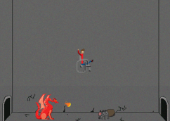

Global Game Jam
The Global Game Jam (GGJ) is the world's largest game creation event taking place around the world at physical locations. In January 2016, there were 36,164 people registered for 632 jam sites in 93 countries and 6,866 games were produced.
Goshen College was one of the sites, drawing people from as far away as Ball State University as well as Goshen College students Mikol Aspinwall, Diona Beck, Yanini Davilla, Kendall Friesen, Carter McKay-Epp, Kendall Miller, Jacob Nofziger, Deeksha Pagar, Matthew Pletcher, Christian Stoltzfus, & Nimoy Vaidya.
This year, the GGJ will be held January 20-22, 2017.

Slide 23
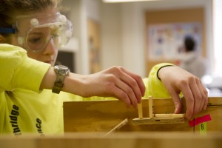

Science Olympiad
Over 100 students, faculty, and community members volunteered to run 23 events for 8 middle school and 13 high school teams on Saturday, February, 13, 2016.
This year, the Goshen College Regional Tournament will be on Saturday, February 11, 2017.

Slide 24
Alicia Showalter Reynolds Scholarship
Awarded to women who are considering graduate studies in the sciences
Sophie Sears & Cecilia Lapp Stoltzfus (2015-16)
No one (2016-17)

Slide 25
Clemens Scholarship
Awarded to an upper-level Chemistry major in honor of Don Clemens’ 30+ years as a Chemistry Professor
Stuart Kurtz (2015-16)
Lauren Wenger (2016-17)

Slide 26
Leaf Scholars
Academically talented first-generation students majoring in STEM.
Money provided by the National Science Foundation.
First Years: Ameera Alshuga, Tyler Lautenschleger, Felix Ortiz, Cassie Rivera
Sophomores: Morgan Catron, McKinzi Vega
Juniors: Philip Chan, Meghan Gerke, Bryan Nguyen, Dmitriy Shendel
Senior: Josue De La Rosa

Slide 27
Sarah G. Rody Scholarship
Awarded to women majoring in computing or mathematics
Lydia Miller (2015-16)
Meghan Gerke (2016-17)

Slide 28
Mathematics Instructors' Scholarship
Awarded annually to mathematics majors seeking secondary certification
Leah Landis, Rae Ann Miller & Colleen Weldy (2016-17)

Slide 29
General Chemistry Achievement Award
Presented by Professor Dan Smith
Awarded to the highest achieving students in General Chemistry
Prizes provided by CRC Press
Mark Kreider

Slide 30
Math Book Awards
Awarded to first-year students for outstanding achievement in 200+ level mathematics courses.
Started with a donation from Bruce Sellers
Rae Ann Miller (Calculus I, Discrete Math)
Christian Stoltzfus (Discrete Math, Calculus II)
Spencer Aeschliman (Calculus II)
Austin Hooley (Calculus I)
Trent Yoder (Calculus I)

Slide 31
Celebrate Science!
Scientific activities Goshen College students will engage in this year.

